Slide 1
802 Project Summary
Maksuda Toma, Jo Charbonneau, and Ryan Lalicker

Slide 2
Background & Context
The consumption of beef jerky has been linked to several illnesses and hospitalizations, most of which involving E. Coli or Salmonella. (Brown et al., 2024).
Our clients were interested in the effect of two different inoculation methods on Salmonella populations in beef jerky of different thicknesses. The variables involved were:
Salmonella counts
Inoculation methods (dry and wet)
Thickness (¼ inch and ⅛ inch)
Time (weeks 1-5)

Slide 3
Design
2x2 factorial design with repeated measures over time:
Inoculation method (dry vs. wet)
Thickness (¼ & ⅛ inch)
5 equally spaced time points (Weeks 1-5)
5 Batches

Slide 4
Model
𝑌_{𝑖𝑗𝑘𝑙}: Salmonella Level
𝜇: overall mean
𝛼_{𝑖} :the effect of the 𝑖th inoculation method
𝛽_{𝑗}: the effect of the 𝑗th thickness level
𝜏_{𝑘}: r the effect of the 𝑘th week
(𝛼𝛽)_{𝑖j}: interaction effect of the 𝑖th inoculation method and the 𝑗th thickness level
(𝛼𝛽𝜏)_{𝑖𝑗𝑘}: three-way interaction between all fixed effects
𝑢_{𝑙}: random effect for batches
𝑒_{𝑖𝑗𝑘l} : residuals
𝑌_{𝑖𝑗𝑘𝑙} = 𝜇 + 𝛼_{𝑖} + 𝛽_{𝑗} + 𝜏_{𝑘} + (𝛼𝛽)_{𝑖𝑗} + (𝛼𝜏)_{𝑖𝑘} + (𝛽𝜏)_{𝑗𝑘} + (𝛼𝛽𝜏)_{𝑖𝑗𝑘} + 𝑢_{𝑙} + 𝑒_{𝑖𝑗𝑘l}

Slide 5
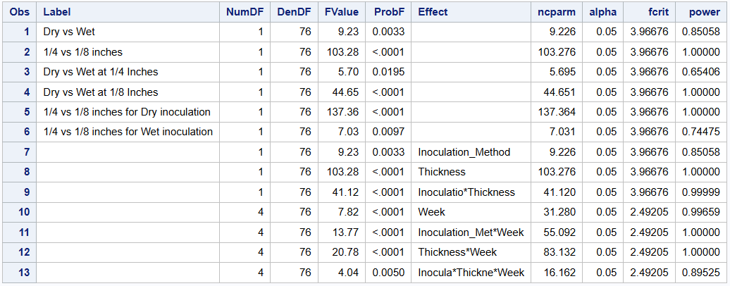
Power Analysis
Client wanted contrasts for:
Difference between inoculation methods (dry and wet)
Difference between thickness (¼ and ⅛ inch)
Difference in the interaction of these variables
Generated dataset with five batches and identical response variables across batches. (Brown et al., 2024).
The dataset was then evaluated to determine the power.
Many terms show >80% power so we chose to proceed

Slide 6
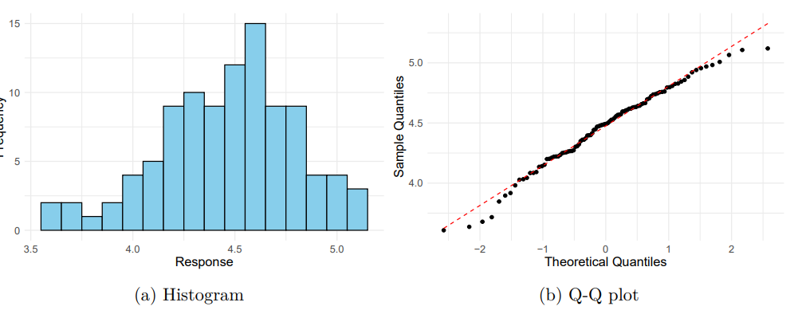
Distribution of Response
Plots to show distribution of response variable:
Histogram indicates a slight skew, but not enough to say the distribution is not normal
Q-Q plot is indicative of a normal distribution

Slide 7
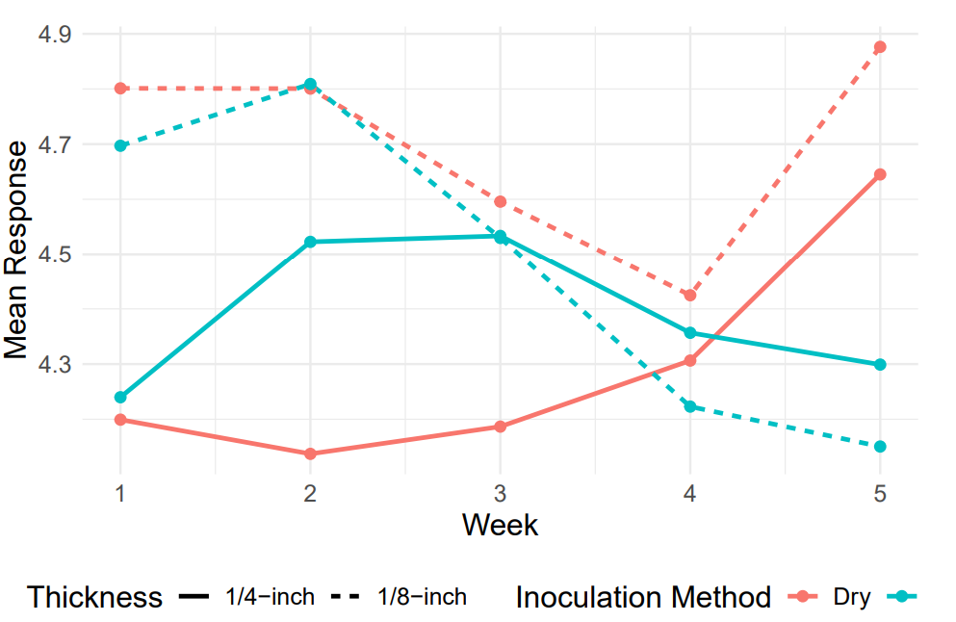
Exploration
Wet inoculation method (blue lines) - mean response tends to decrease over time
Dry Inoculation (red lines) - mean response tends to increase over time
⅛ inch thickness - responses were similar, diverging at the end of the experiment
¼ inch thickness - Showed more variation

Slide 8
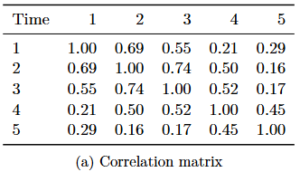
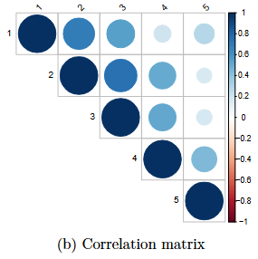
Correlation Over Time
Since this is a repeated measures experiment, we need to account for this variance by selecting a covariance structure.
Plan to use AR(1) structure
Suited for equally spaced, ordered data over time
Strong correlations observed between adjacent weeks
Week 1 vs. Week 2 (r = 0.69)
Week 2 vs. Week 3 (r = 0.74)
Correlations weaken as time gap increases

Slide 9
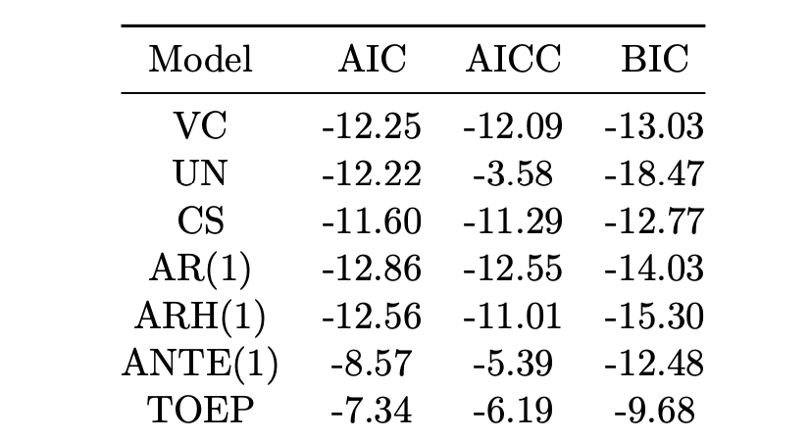
Model Comparison
While confident in AR(1), we also tested other covariance structures for comparison.
From the model comparison:
AR(1) structure is the best fit with the lowest AIC and AICC, and a respectable BIC score

Slide 10
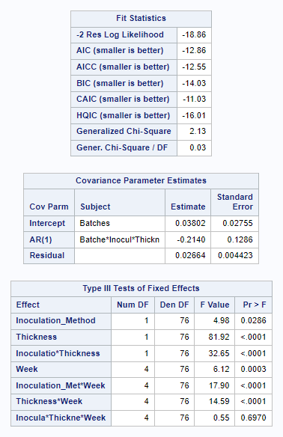
Model Results
The model successfully converged, with variance estimates for random intercepts (batches: 0.03802) and residuals (0.02064). suggest that the model fits the data reasonably well, indicating minimal unexplained variability, and the SE (0.004423) confirming the reliability of this estimate.
The AR(1) autocorrelation (-0.2140) indicates weak negative correlation between adjacent time points.
Highly significant interactions for all two-way interactions (𝑝<0.0001) while the three-way interaction (𝑝=0.6970) is not significant.

Slide 11
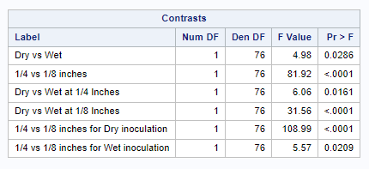
Contrast Result
While both the inoculation method and thickness are significant, this is just the main effects for the model. Therefore, we need to focus on the interaction terms.
All interaction contrasts are significant, with Dry vs. Wet at 1/8 inches and 1/4 vs. 1/8 inches for Dry being highly significant.
This highlights that the bacteria seems to grow higher when dry inoculated at the two thicknesses levels (especially on 1/8 inches)

Slide 12
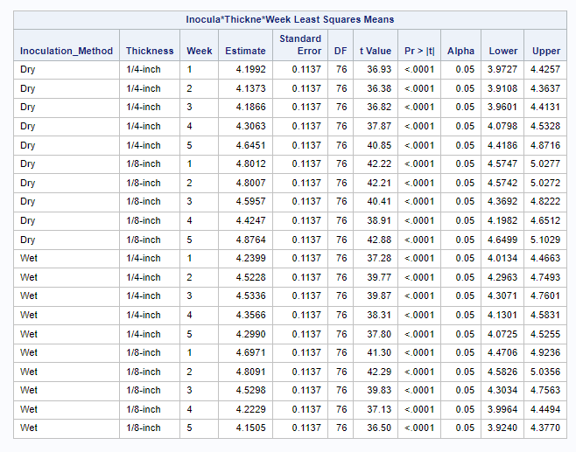
Model Results
LSMeans Overview:
The table shows the estimated response for combinations of Inoculation Method, Thickness, and Week, with all combinations being highly significant (𝑝<0.0001) and confidence intervals confirming reliability
Trends:
For 1/4-inch thickness, both Dry and Wet methods show increases over time, with Dry typically having higher responses. For 1/8-inch thickness, the differences between Dry and Wet are smaller but still notable.

Slide 13
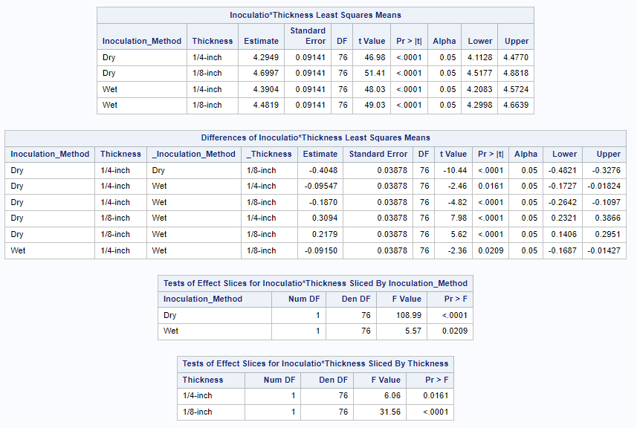
Model Results- Method*Thickness
The estimate for the Salmonella levels is largest with a dry inoculation at 1/8 of an inch, while the smallest was at 1/4 of an inch.
Significant differences are observed between Dry and Wet methods, with Wet generally performing more consistently.
The largest significant difference is among the dry methods and the smallest is for the wet methods.

Slide 14
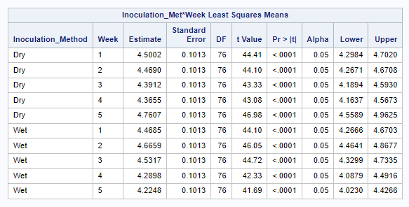
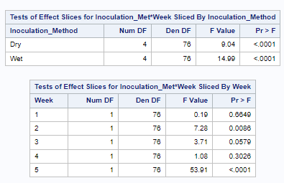
Model Results- Method*Week
The interaction between inoculation method and time is evident, with dry inoculation showing an increase in week 5 and wet inoculation peaking earlier. This indicates that the timing of bacterial growth depends on the inoculation method used.
The interaction between Inoculation method and week is significant, with differences in bacterial growth patterns being particularly pronounced for week 5, where the dry method shows significantly higher responses than wet. This suggests the impact of inoculation method depends on the week of measurement.

Slide 15
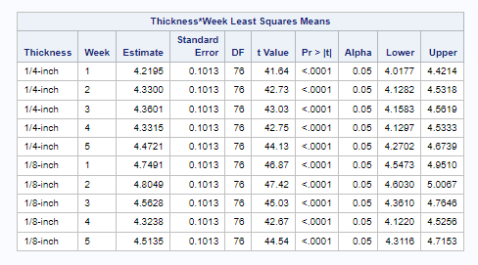
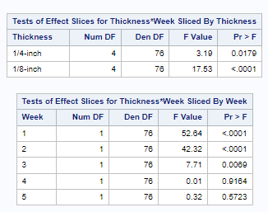
Model Results- “Thickness*Week”
The 1/8-inch thickness indicates higher bacterial growth compared to 1/4-inch across all weeks, with Week 2 showing the highest estimate for 1/8-inch. This highlights that the combination of thinner slices and Week 2 conditions create the most favorable environment for bacterial growth. The estimates generally increases over time for 1/4-inch.
The 1/8-inch thickness shows greater variability in bacterial growth across weeks, highlighting its susceptibility. Thickness differences are most significant in weeks 1 and 2, where thinner slices (1/8-inch) show much higher bacterial growth than thicker slices (1/4-inch). By week 5, the effect of thickness diminishes, suggesting bacterial growth stabilizes between the two thicknesses.

Slide 16
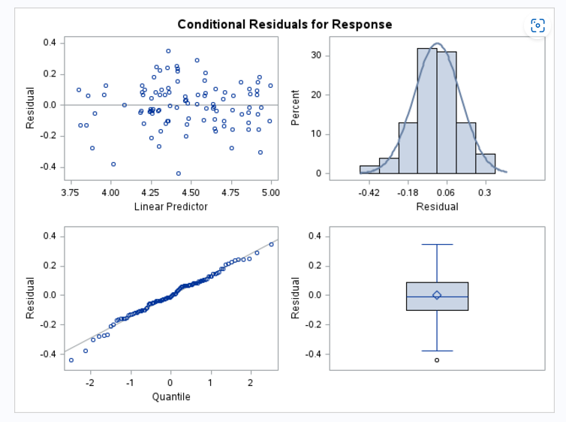
Model Result- Assumption Checking
The histogram and Q-Q plot indicate that residuals are approximately normal, supporting the normality assumption
The residual plot shows no clear pattern, suggesting that the assumption of constant variance (homoscedasticity) holds
The boxplot shows one potential outlier, but it does not significantly impact normality
Overall, residual diagnostics confirm that the key assumptions of the model are satisfied.

Slide 17
Conclusion
Use thicker slices (1/4-inch) to minimize bacterial growth and ensure uniform thickness during processing.
If both slices will be used, prioritize the wet inoculation method over dry, as it consistently results in lower bacterial growth
To reduce bacterial growth, focus on critical weeks: prioritize monitoring Week 2 and Week 5 for inoculation methods, as these show significant differences between the dry and wet methods, and Week 1 and Week 2 for thickness, as 1/8-inch slices are more prone to bacterial growth.

Slide 18
Citations
Bobbit, Zach. 2021. “How to Interpret Negative AIC Values.” Statology. 2021.https://www.statology.org/negative-aic/.
Brown, Jessica, Taylor Bannon, Arie Havelaar, Chad Carr, Barbara B. Kowalcyk, and JasonM. Scheffler. 2024. “Inactivation of Salmonella Enterica, Escherichia Coli O157:H7, andCampylobacter Jejuni in a Restructured Beef Jerky Developed for Production in Ethiopia.”Meat and Muscle Biology8 (April): 1–12.https://doi.org/10.22175/mmb.16091.
Lipka, Alex, and Benjamin Tyner. 2004. “Repeated Measures Covariance Structure.” Sta-tistical Consulting Service - Purdue University. 2004.https://www.stat.purdue.edu/scs/help/method/Repeated%20measures%20analysis.pdf.
USDA. n.d. “Appendix e: Selecting an Appropriate Covariance Structure,” n.d., E.1–8.https://www.ars.usda.gov/ARSUserFiles/80000000/StatisticsGroupWebinars/Appendix%20E%20-%20Selecting%20a%20Covariance%20Structure.pdf.11

